Slide 1

GenerativeAI and Its Applications
Unit 1
(UE23CS342BA4)
Generative AI and Its Applications
Dr. Pooja Agarwal
Dept. of CSE, PES University, Bangalore

Slide 2

GenerativeAI and Its Applications
Acknowledgement
The slides are prepared from various resources from the Universities from abroad and India. Also, some material is taken from reliable resources from internet throughout this course.

Slide 3
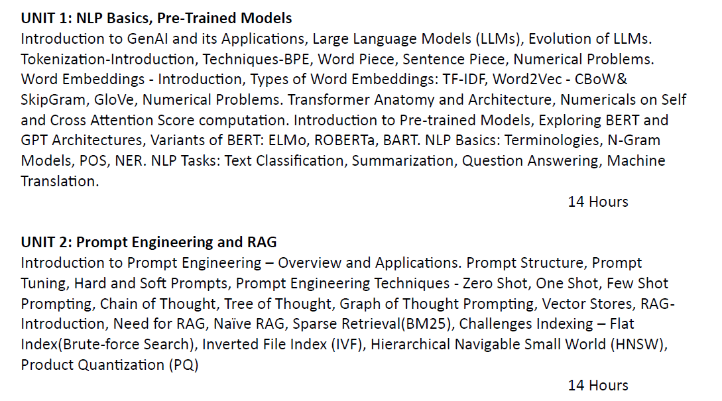
GenerativeAI and Its Applications
Syllabus

Slide 4
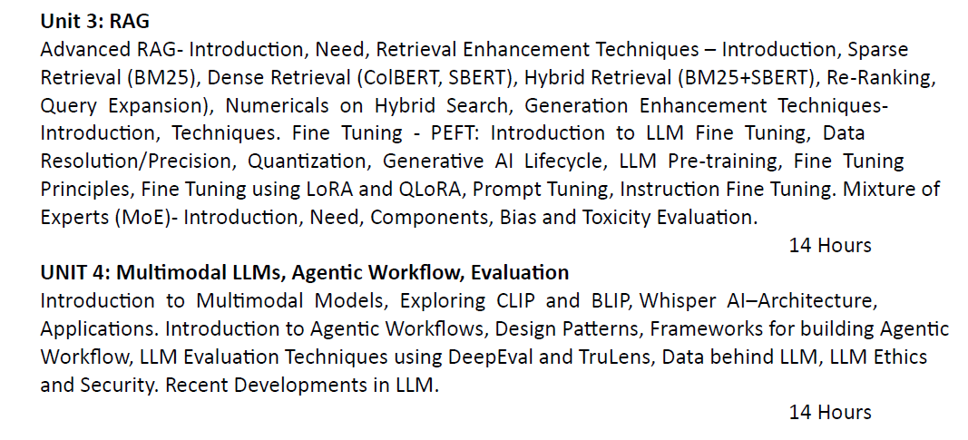
GenerativeAI and Its Applications
Syllabus

Slide 5
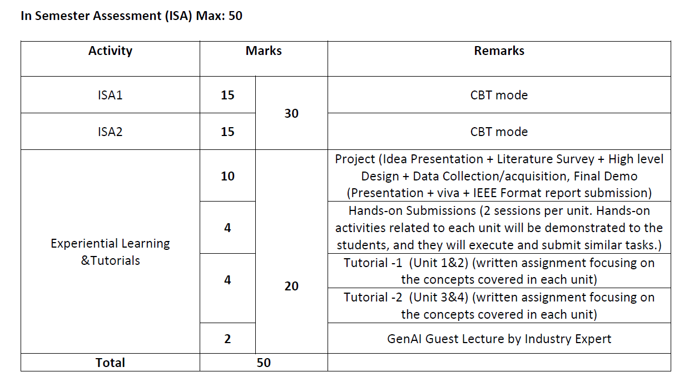
GenerativeAI and Its Applications
Evaluation Policy (UE23CS342BA4)

Slide 6
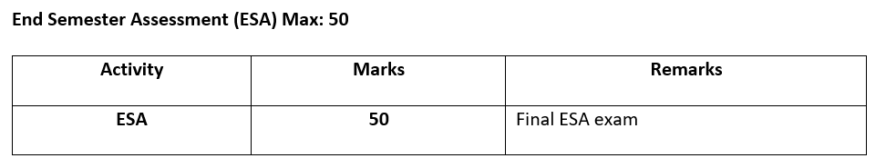
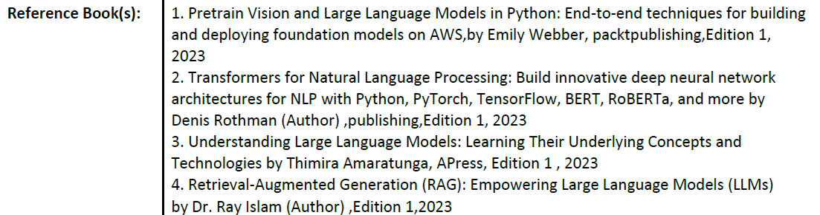
GenerativeAI and Its Applications
Evaluation Policy

Slide 7
GenerativeAI and Its Applications
Course Information
Text Book
Project Guidelines

Slide 8
Project Ideas
1. Text Generation
Objective: Generate coherent and meaningful text based on a given prompt.
Tools: Use pre-trained models like GPT-2 or GPT-3.
Steps:
Fine-tune a pre-trained LLM on a specific dataset (e.g., fairy tales, news articles).
Generate text based on various prompts.
Learning Outcomes: Understanding the basics of text generation and prompt engineering.

Slide 9
Project Ideas
2. Chatbot Development
Objective: Create a simple chatbot that can carry on basic conversations.
Tools: Use GPT-3 or a smaller model like DialoGPT.
Steps:
Set up a basic conversational interface.
Fine-tune the model if necessary for specific dialogue styles or topics.
Learning Outcomes: Practical experience with dialogue systems and LLM API usage.

Slide 10
Project Ideas
3. Text Summarization
Objective: Develop a tool that can summarize long articles into shorter, coherent summaries.
Tools: Use models like BART or T5.
Steps:
Fine-tune a summarization model on a news dataset or any text corpus.
Evaluate the quality of the summaries produced.
Learning Outcomes: Insights into text summarization techniques and model evaluation.

Slide 11
Project Ideas
4. Sentiment Analysis
Objective: Analyze the sentiment of given text data (positive, negative, neutral).
Tools: Use pre-trained models like BERT or RoBERTa.
Steps:
Fine-tune a sentiment analysis model on a dataset like IMDb reviews.
Implement a simple interface to input text and display sentiment results.
Learning Outcomes: Understanding text classification and model fine-tuning.

Slide 12
Project Ideas
5. Named Entity Recognition (NER)
Objective: Identify and classify named entities (e.g., people, organizations, locations) in text.
Tools: Use models like SpaCy or BERT-based NER models.
Steps:
Fine-tune an NER model on a labeled dataset.
Create a tool to highlight named entities in the input text.
Learning Outcomes: Practical experience with NER and understanding entity recognition.

Slide 13
Project Ideas
6. Language Translation
Objective: Build a simple tool for translating text from one language to another.
Tools: Use models like MarianMT or M2M100.
Steps:
Set up the translation model with pre-trained weights.
Translate text between selected language pairs and evaluate accuracy.
Learning Outcomes: Insights into machine translation and handling multilingual data.

Slide 14
Project Ideas
7. Text-Based Games
Objective: Create interactive text-based games (e.g., trivia, adventure).
Tools: Use GPT-2 or GPT-3.
Steps:
Develop game logic and integrate it with the LLM.
Fine-tune the model for better game-specific responses if necessary.
Learning Outcomes: Combining creativity with LLMs to build engaging applications.

Slide 15
Project Ideas
8. Fake News Detection
Objective: Classify news articles as real or fake.
Tools: Use BERT or RoBERTa.
Steps:
Fine-tune a classification model on a dataset of real and fake news.
Build an interface to input news articles and display classification results.
Learning Outcomes: Understanding text classification and ethical considerations in AI.

Slide 16
Project Ideas
9. Medical Question Answering System
Objective: Develop a system that can answer common medical questions.
Tools: Use GPT-3 or similar LLMs.
Steps:
Compile a dataset of frequently asked medical questions and their answers.
Fine-tune the LLM on this dataset if necessary.
Create an interface where users can input questions and receive answers.
Learning Outcomes: Understanding how to use LLMs for information retrieval and healthcare communication.

Slide 17
Project Ideas
10. Symptom Checker
Objective: Create a tool that suggests possible conditions based on described symptoms.
Tools: Use GPT-3 or other LLMs.
Steps:
Build a dataset mapping symptoms to potential conditions.
Fine-tune the LLM to understand and analyze symptom descriptions.
Develop a user interface to input symptoms and display possible conditions.
Learning Outcomes: Insights into medical symptom analysis and user interaction with AI tools.

Slide 18
Project Ideas
11. Automated Essay Grader
Objective: Create a tool to evaluate and grade student essays.
Tools: Use BERT or GPT-3.
Steps:
Gather a dataset of student essays with grades provided by teachers.
Train or fine-tune the model to evaluate essays based on various criteria (e.g., coherence, grammar, content).
Develop a user interface for students to submit essays and receive feedback.
Learning Outcomes: Insights into automated evaluation and feedback mechanisms in education.

Slide 19
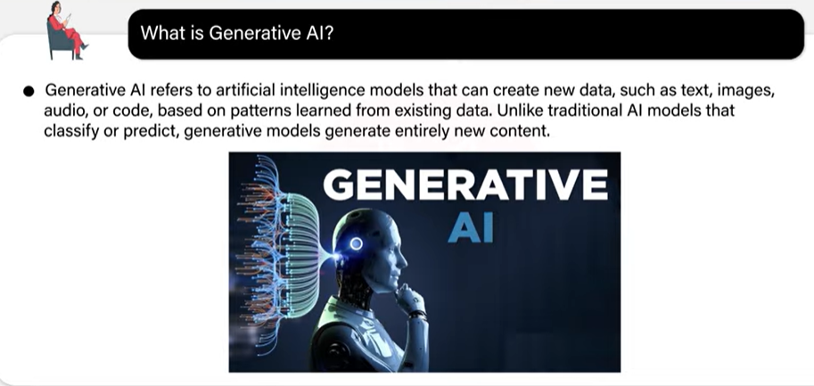
Generative AI

Slide 20
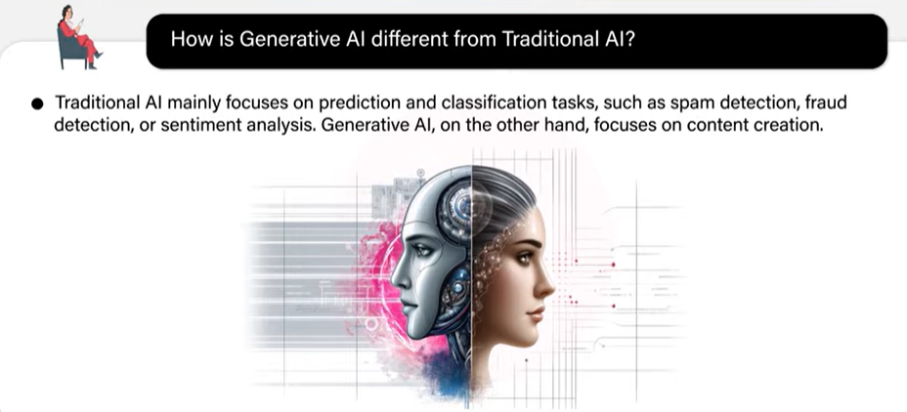
How is GenAI different from Tradition AI

Slide 21
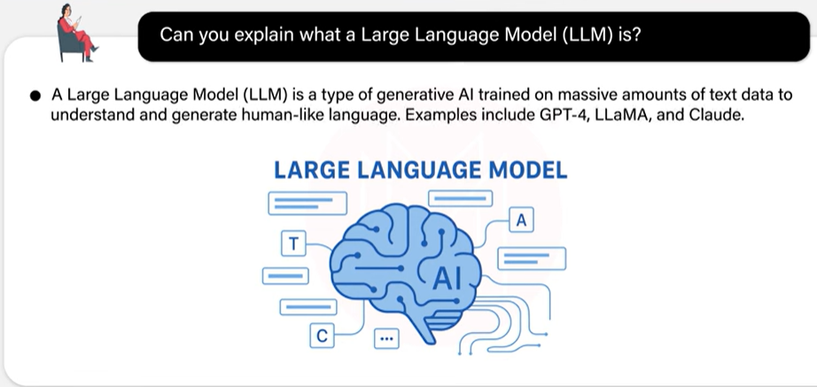
LLM

Slide 22
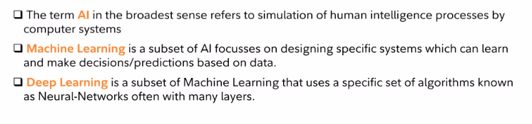
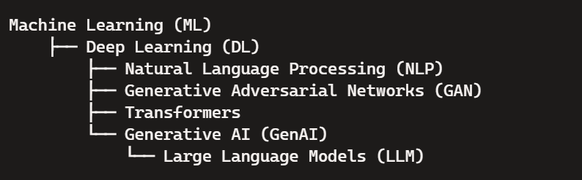
GenerativeAI and Its Applications
Artificial Intelligence, Machine Learning and Deep Learning

Slide 23
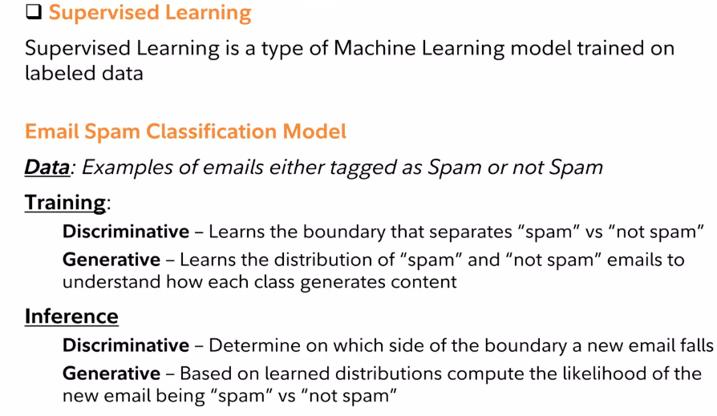
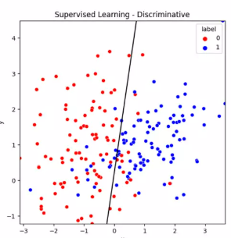
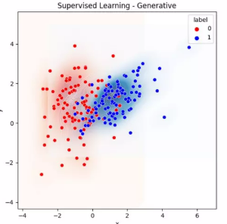
GenerativeAI and Its Applications
Types of Machine Learning Models

Slide 24
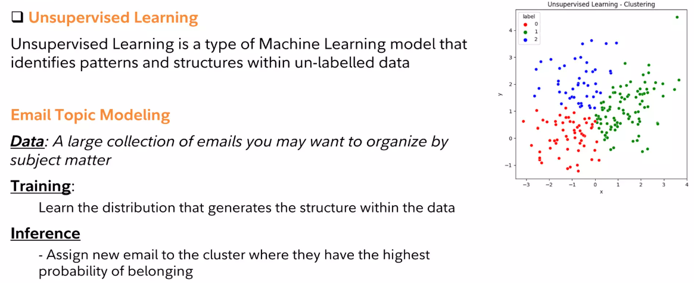
GenerativeAI and Its Applications
Types of Machine Learning Models

Slide 25
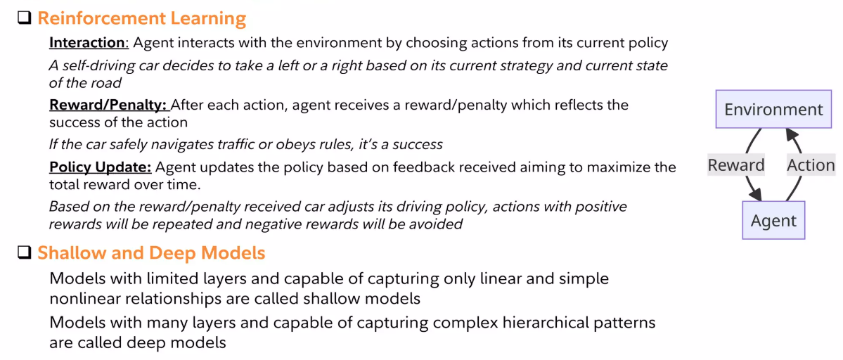
GenerativeAI and Its Applications
Types of Machine Learning Models

Slide 26
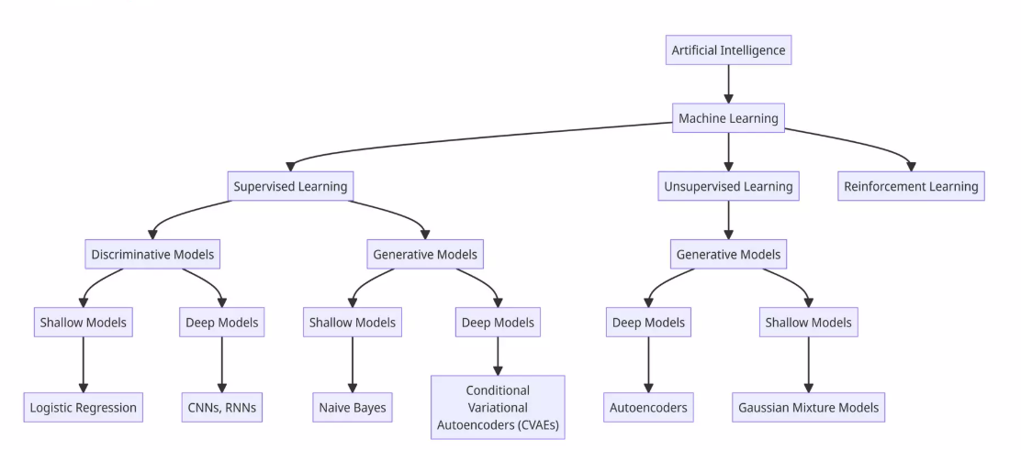
GenerativeAI and Its Applications
Summary

Slide 27
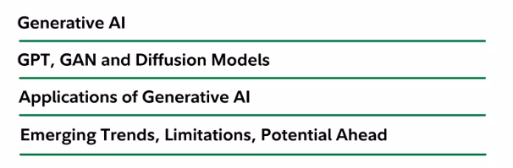
GenerativeAI and Its Applications

Slide 28
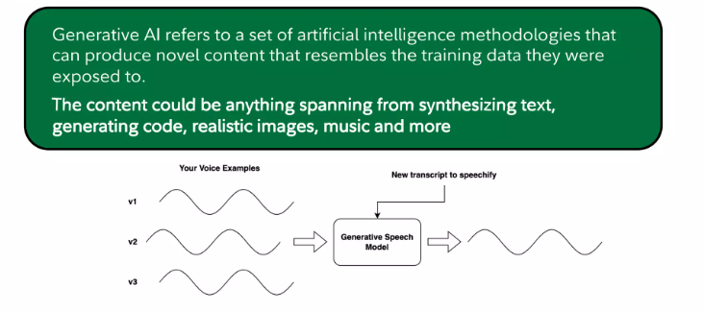
GenerativeAI and Its Applications
Generative AI (Definition)

Slide 29
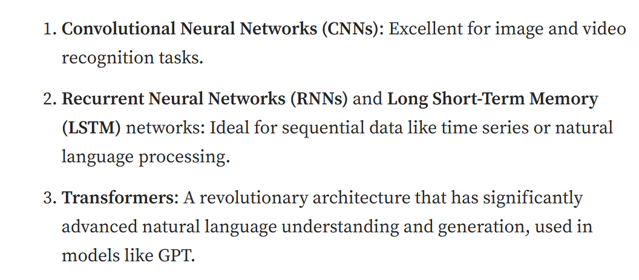
GenerativeAI and Its Applications
Generative Pre-Trained Transformer (GPT)

Slide 30
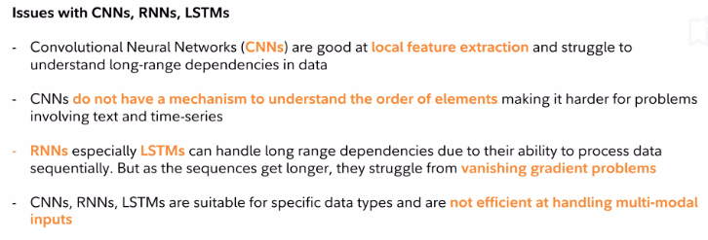
GenerativeAI and Its Applications
Generative Pre-Trained Transformer (GPT)

Slide 31
GenerativeAI and Its Applications
VERY IMPORTANT
AI enables ML, ML enables DL, DL enables Generative AI; Transformers power modern GenAI models such as GPT, BERT, and BART, collectively known as Large Language Models, while GANs represent a parallel generative framework.

Slide 32
GenerativeAI and Its Applications
LLM
LLMs, or Large Language Models, are the key component behind text generation.
In a nutshell, they consist of large pretrained transformer models trained to predict the next word (or, more precisely, token) given some input text.
Since they predict one token at a time, you need to do autoregressive generation to generate new sentences. (Hugging Face)
We can see LLMs as language models with larger architecture (a larger number of weights), trained on larger dataset while requiring a larger amount of resources (hardware and software) and capable of performing a larger set of tasks with greater efficiency compared to the traditional language models.

Slide 33
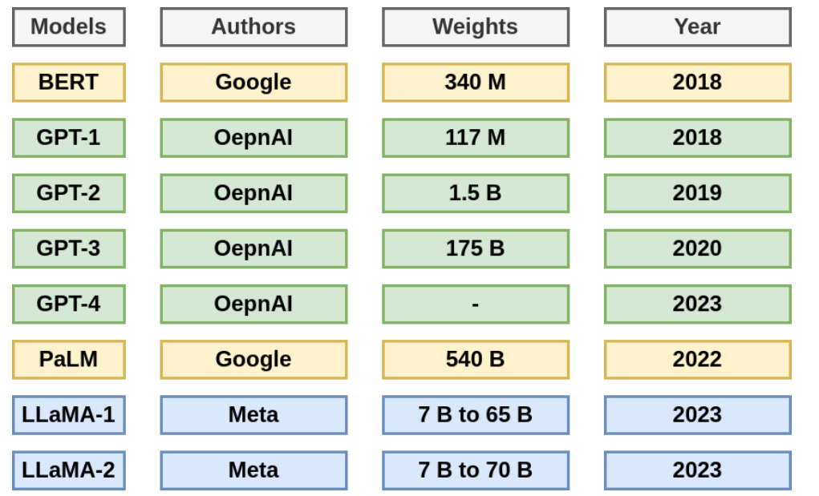
GenerativeAI and Its Applications
SOME LLMs

Slide 34
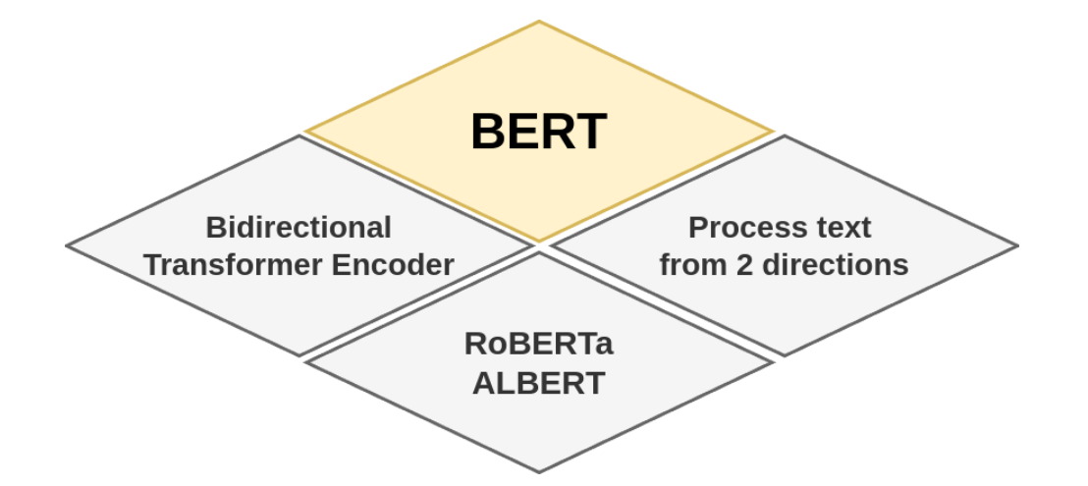
GenerativeAI and Its Applications
BERT
Bidirectional Encoder Representations from Transformers [5], or BERT for short, is one of the earliest LLM models that’s published in 2018 by Google research team. It’s a transformer based deep neural network that processes the text from both directions (left-to-right and right-to-left).

Slide 35
GenerativeAI and Its Applications
BERT
The BERT’s model architecture consists of a bidirectional Transformer encoder with a total of 340M parameter. BERT’s input can be a single sentence or a pair of sentences packed together into a single sequence where every sentence starts with the token [CLS] and the pair of sentences are separated by a special token [SEP].
BERT is pre-trained on Books Corpus with 800M words and English Wikipedia with 2500M words and can be finetuned by just adding an output layer to create models for several tasks such as question answering.

Slide 36
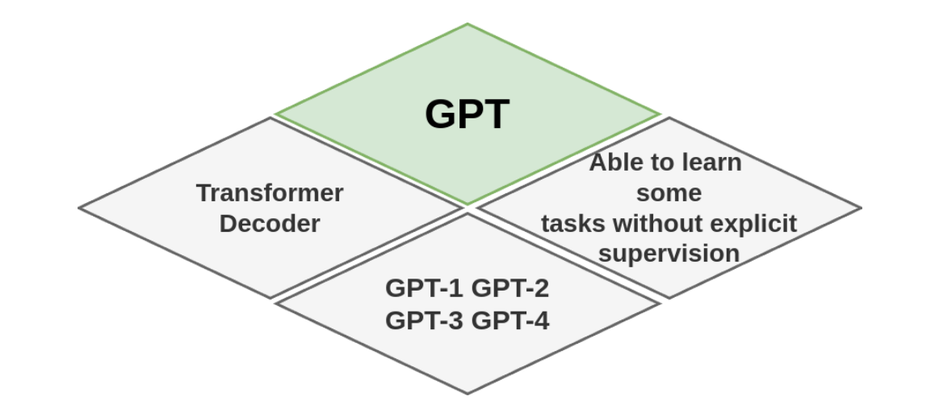
GenerativeAI and Its Applications
Generative Pre-Trained Transformer (GPT)
Generative Pre-trained Transformer, or GPT for short, is a series of LLMs developed by OpenAI. As BERT, GPT models are transformer-based deep neural networks pre-trained on large amounts of text data.

Slide 37
GenerativeAI and Its Applications
Generative Pre-Trained Transformer (GPT)
GPT-1 is the first LLM of this series that’s published in 2018.
It consists of a 12-layer Transformer decoder with a total of 117M parameters.
Similarly to BERT, GPT-1 is pre-trained on Books Corpus and can be finetuned by adding an output layer to create models for more specific natural language processing tasks, such as question answering and machine translation.
GPT-2 is the second LLM of the GPT family that’s published in 2019.
The GPT-2 model follows the GPT-1 architecture with a total of 1.5B parameters.
It was trained on a larger dataset, WebText, after removing Wikipedia documents for analysis sake.
Another particularity of this model, is that it’s able to learn some tasks without explicit supervision, in other words, no fine tuning was needed (zero-shot task transfer).

Slide 38
GenerativeAI and Its Applications
Generative Pre-Trained Transformer (GPT)
GPT-3 came in 2020 to demonstrate that increasing the language models size improves the performance across various tasks without task-specific training.
Its architecture is similar to GPT-2 with a total of 175B parameters and it was trained with an even larger dataset compared to GPT-2.
GPT-4 [11] is the most powerful LLM in the GPT family launched in 2023.
It’s a multimodal model transformer-based LLM that can take text and image and input and output text.
GPT-4 is pre-trained using public datasets and licensed datasets to predict the next token and then finetuned using Reinforcement Learning from Human Feedback, RLHF for short, a machine learning approach to improve model performance.

Slide 39
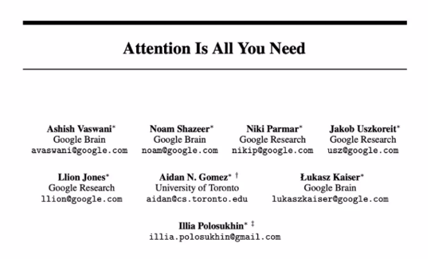
GenerativeAI and Its Applications
Generative Pre-Trained Transformer (GPT)
In general, the architecture of LLMs is based on the Transformer model published in the paper: Attention is all you need (in 2017).
A transformer is an encoder-decoder architecture with the self-attention mechanism.
The encoder maps the input sequence of symbol representation to a sequence of continuous representation while the decoder generates from the encoder output, a sequence of symbols for one element at a time.
The self-attention mechanism here, enables the Transformer to capture dependencies between words.

Slide 40
GenerativeAI and Its Applications
Generative Pre-Trained Transformer (GPT)
Some of the LLMs, like the BERT family, follow the encoder-only architecture design that focuses on understanding the context of the input text such as text classification.
Some other LLMs, like GPT, PaLM and LLaMA families, opted for decoder-only architecture design that focuses on generating output text based on the provided context.

Slide 41
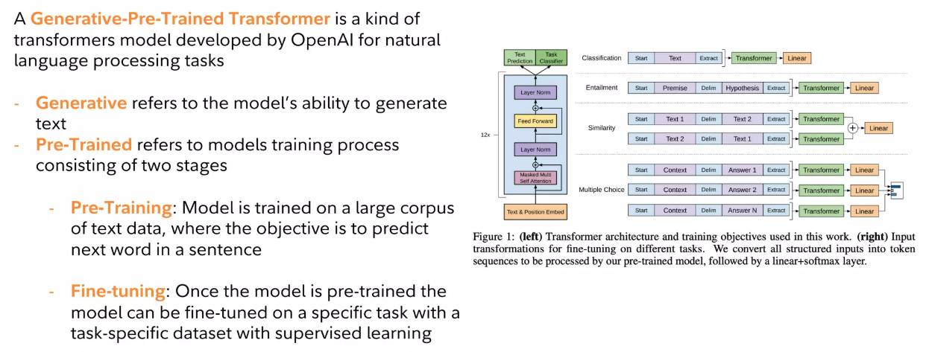
GenerativeAI and Its Applications
Generative Pre-Trained Transformer (GPT)

Slide 42
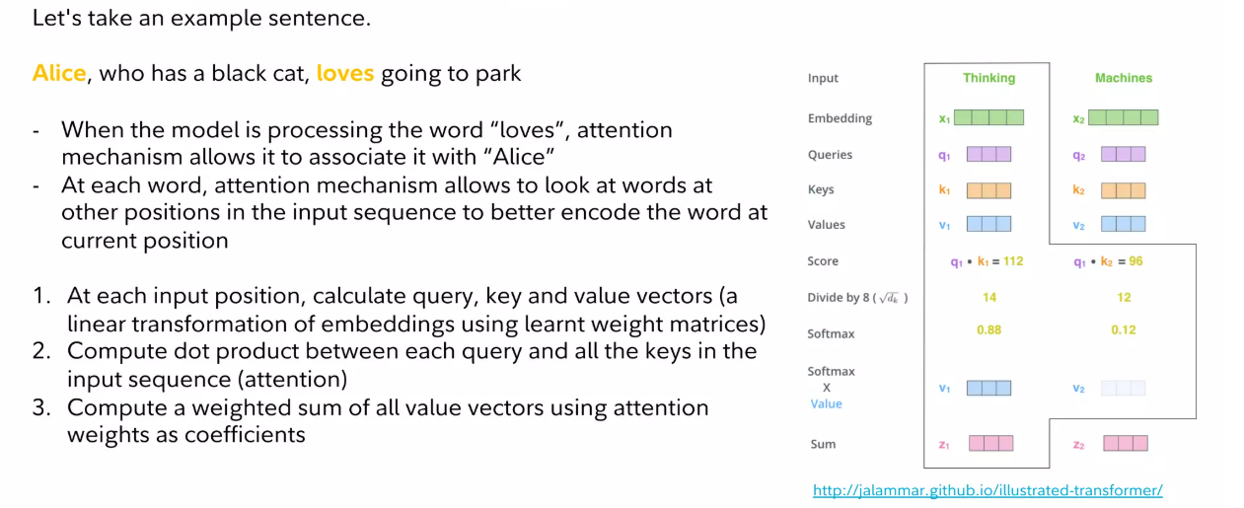
GenerativeAI and Its Applications
Generative Pre-Trained Transformer (GPT)

Slide 43
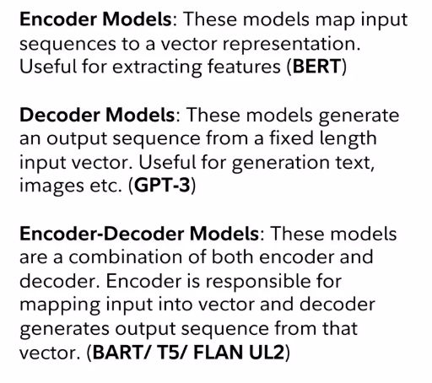
GenerativeAI and Its Applications
Generative Pre-Trained Transformer (GPT)

Slide 44
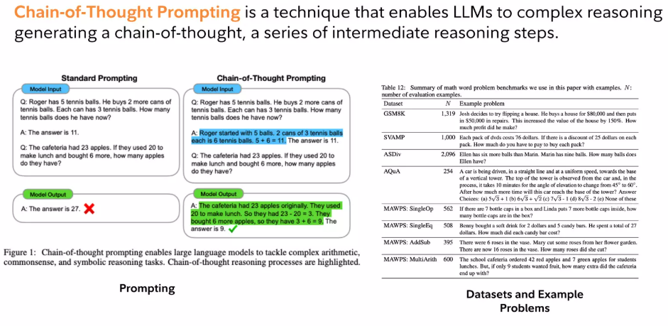
GenerativeAI and Its Applications
Generative Pre-Trained Transformer (GPT) – Chain of thought Prompting

Slide 45
GenerativeAI and Its Applications
LLMs Input and Output
LLMs was initially proposed to work on text data: they often take raw text as input that can be sentences, paragraphs or documents and output text that can also be sentences, paragraphs and or documents.
The raw input is typically transformed into tokens that represent words or subwords units depending on the employed tokenization algorithm.
Similarly, LLMs typically output tokens that can be converted back into human-readable text using the model’s tokenizer.
Some recent LLMs operate not only on text but also images to generate text output like GPT-4. Other LLMs went beyond that to operate on videos and audio also and generate images alongside texts like Gemini.
More complex architecture generally called Multimodal Language Models (MLMs).

Slide 46
GenerativeAI and Its Applications
Use Cases of LLM
LLMs have a wide range of applications and across various fields
Text classification: that consists of classifying text into defined classes or labels like in sentiment analysis, spam detection and document classification.
Named entity recognition: that consists of detecting entities mentioned in text such as names of people or locations.
Question answering: that consists of generating answers to questions while considering the context.
Text generation: that consists of generating relevant text like translating, summarizing and paraphrasing.
Dialogue systems: that consists of building conversational agents, chatbots or assistants that can engage in natural language conversations with users.

Slide 47
GenerativeAI and Its Applications
Use Cases of LLM
LLMs are needed to perform better only on one specific task. Therefore, several techniques have been proposed in order to adapt LLMs to a given task among which we will present fine-tuning and prompting
Fine-tuning
Fine-tuning is a popular approach in machine learning in general. It consists of further training on a specific task or data domain. In LLMs, it’s commonly used for tasks like text classification, sentiment analysis and language translation.
Prompting
In generative AI models, prompting is providing textual input to guide the model’s output. It generally consists of providing questions, instructions, examples or/and input data. There are various variants of prompt engineering techniques including: Chain of Thought (CoT), Tree of Thought (ToT), self-consistency, expert prompting, etc.

Slide 48
GenerativeAI and Its Applications
VERY IMPORTANT
GPT and LLMs generate content sequentially in token space.
GANs and Diffusion models generate content in data space (images, signals) using fundamentally different learning principles.”
“GANs learn to imitate reality rather than predict sequences.”

Slide 49
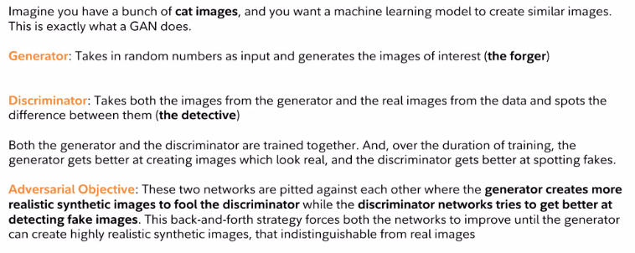
GenerativeAI and Its Applications
GAN – Generative Adversarial Networks

Slide 50
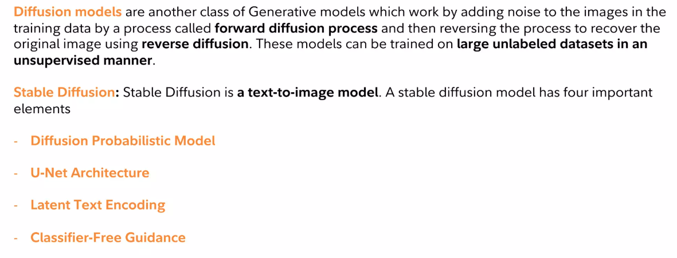
GenerativeAI and Its Applications
Diffusion Models

Slide 51
GenerativeAI and Its Applications
GAN – Generative Adversarial Networks
Diffusion Probabilistic Model (DPM), also known as a Denoising Diffusion Probabilistic Model (DDPM), is a type of
generative model that learns to generate data by reversing a diffusion process.
U-Net Architecture is a type of convolutional neural network designed primarily for biomedical image segmentation.
Applications
Biomedical Image Segmentation: Segmenting medical images such as MRI scans or cell images.
Object Detection: Identifying and locating objects in images.
Satellite Image Analysis: Analyzing geographical and environmental features from satellite imagery.
Autonomous Driving: Segmenting different elements on the road such as lanes, vehicles, and pedestrians.

Slide 52
GenerativeAI and Its Applications
GAN – Generative Adversarial Networks
Latent Text Encoding is a technique used in natural language processing (NLP) and machine learning to transform textual
data into a numerical format that can be processed by machine learning models.
Text Representation
Tokenization: Breaking down the text into smaller units, such as words, subwords, or characters.
Vocabulary: Creating a dictionary of all unique tokens (words, subwords, or characters) in the dataset.
Embedding Techniques
Bag-of-Words (BoW): Represents text by the frequency of each word in a fixed vocabulary. It disregards the word order.
TF-IDF (Term Frequency-Inverse Document Frequency): A numerical representation of text that considers the importance
of a word in a document relative to a collection of documents.
Word Embeddings: Dense vector representations of words that capture their semantic meaning. Common methods include:
Word2Vec: Uses neural networks to learn word embeddings based on their context.
Applications
Text Classification: Assigning predefined categories to text based on its content.
Text Generation: Generating coherent and contextually relevant text based on a given prompt.
Machine Translation: Translating text from one language to another.
Text Summarization: Creating a concise summary of a longer text.

Slide 53
GenerativeAI and Its Applications
GAN – Generative Adversarial Networks
Classifier-Free Guidance (CFG) is a technique used in diffusion models to guide the generation process without
relying on an external classifier
Applications
Text-to-Image Generation: Generating images based on textual descriptions.
Super-Resolution: Enhancing the resolution of images.
Sound Generation: Producing audio samples based on conditions

Slide 54
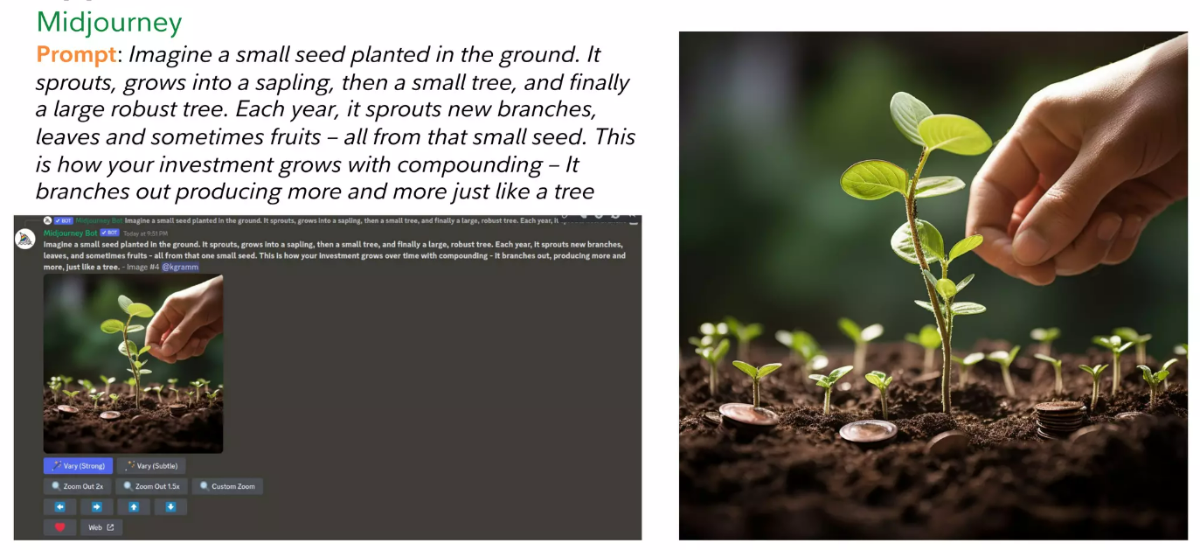
GenerativeAI and Its Applications
Applications

Slide 55
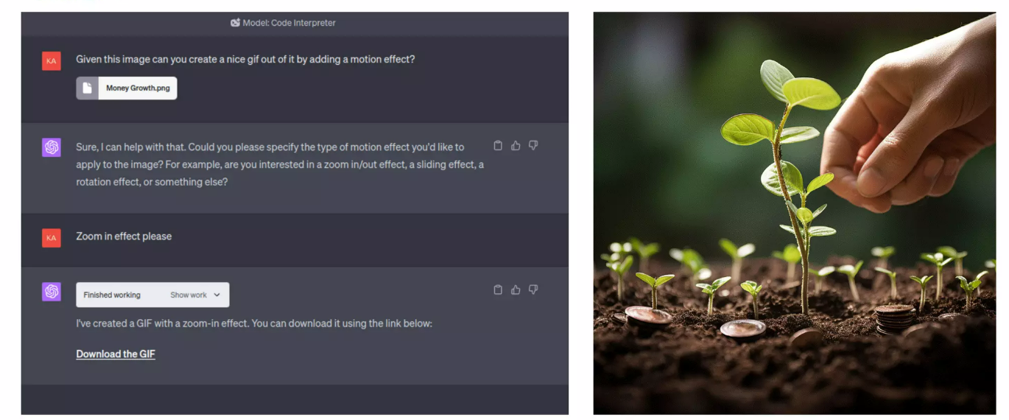
GenerativeAI and Its Applications
Applications: Chatgpt

Slide 56
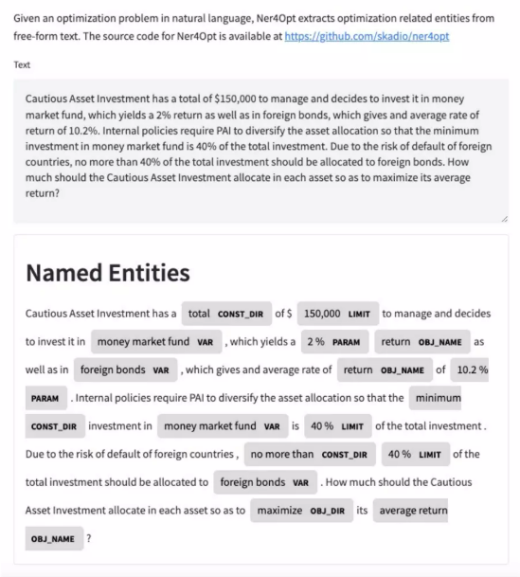
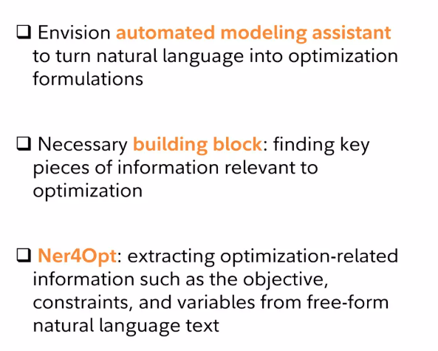
GenerativeAI and Its Applications
Ner4Opt: Named Entity Recognition for Optimization Modelling from Natural Language

Slide 57
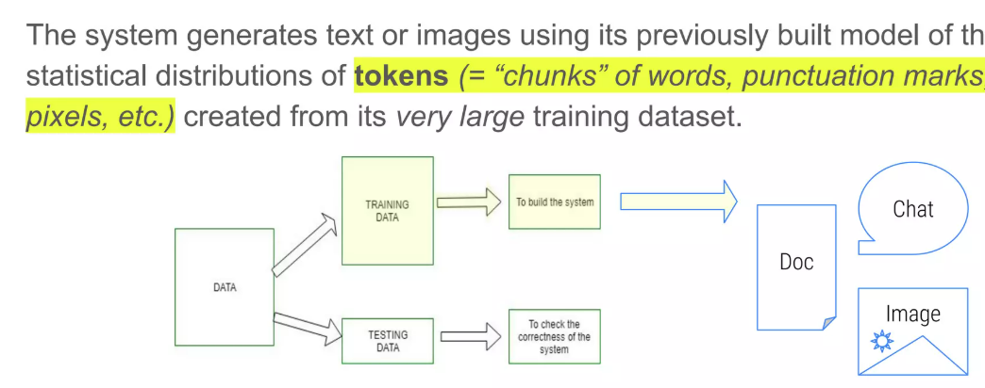
GenerativeAI and Its Applications
How Generative AI Works

Slide 58
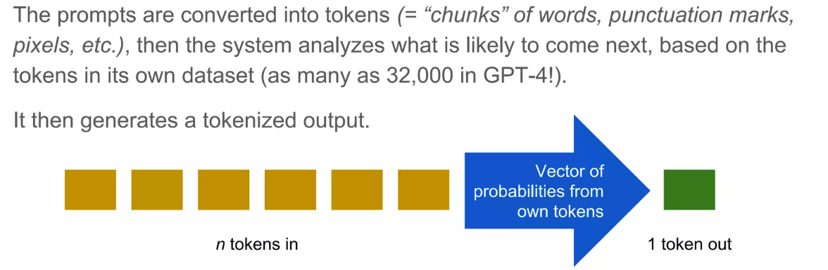
GenerativeAI and Its Applications
How Generative AI Works

Slide 59
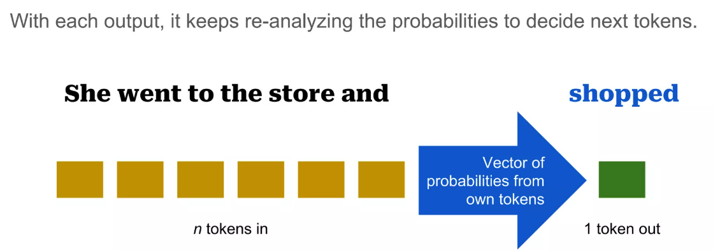
GenerativeAI and Its Applications
How Generative AI Works

Slide 60
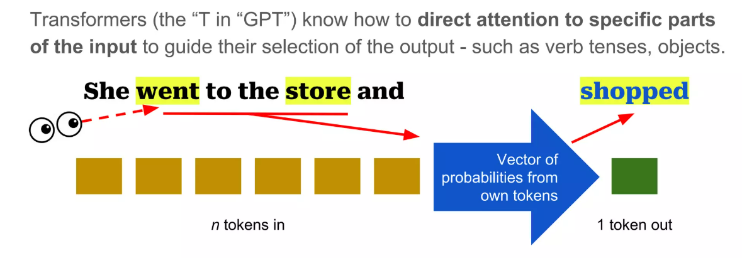
GenerativeAI and Its Applications
How Generative AI Works

Slide 61
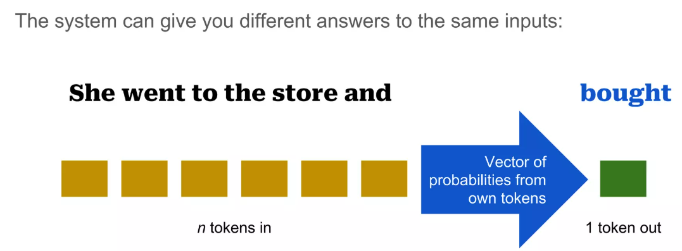
GenerativeAI and Its Applications
How Generative AI Works

Slide 62
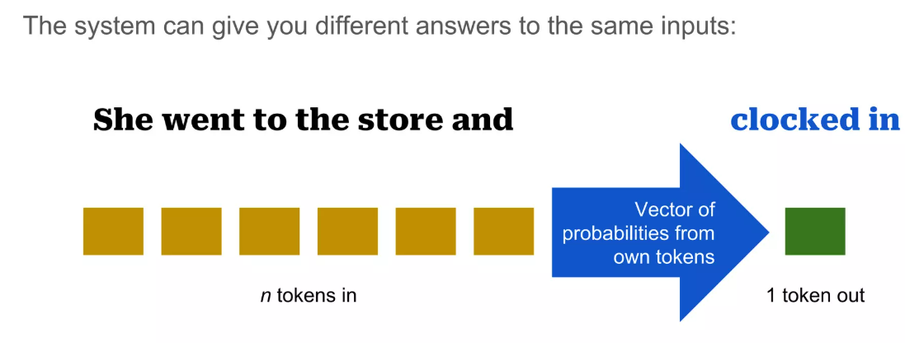
GenerativeAI and Its Applications
How Generative AI Works

Slide 63
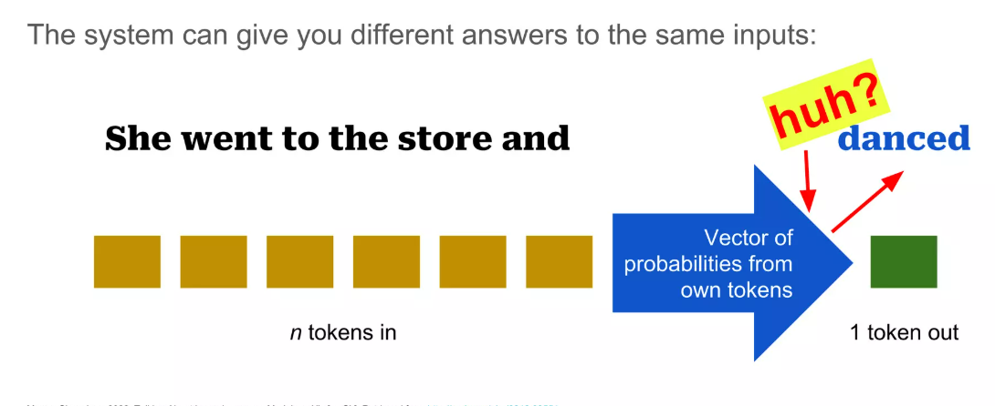
GenerativeAI and Its Applications
How Generative AI Works

Slide 64
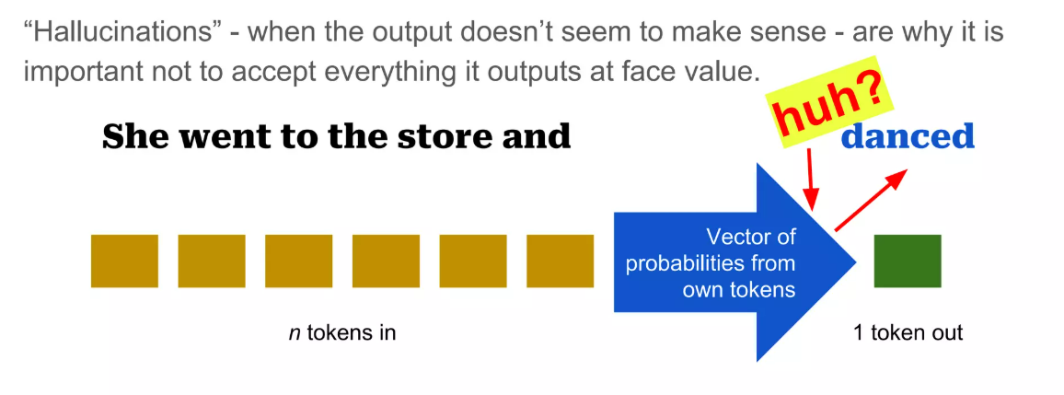
GenerativeAI and Its Applications
How Generative AI Works

Slide 65
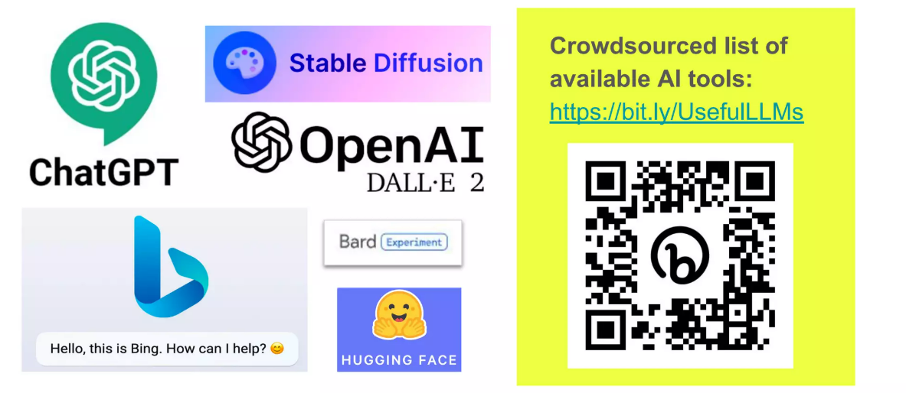
GenerativeAI and Its Applications
Available GenAI Tools

Slide 66
GenerativeAI and Its Applications
Using Generative AI in Academic

Slide 67
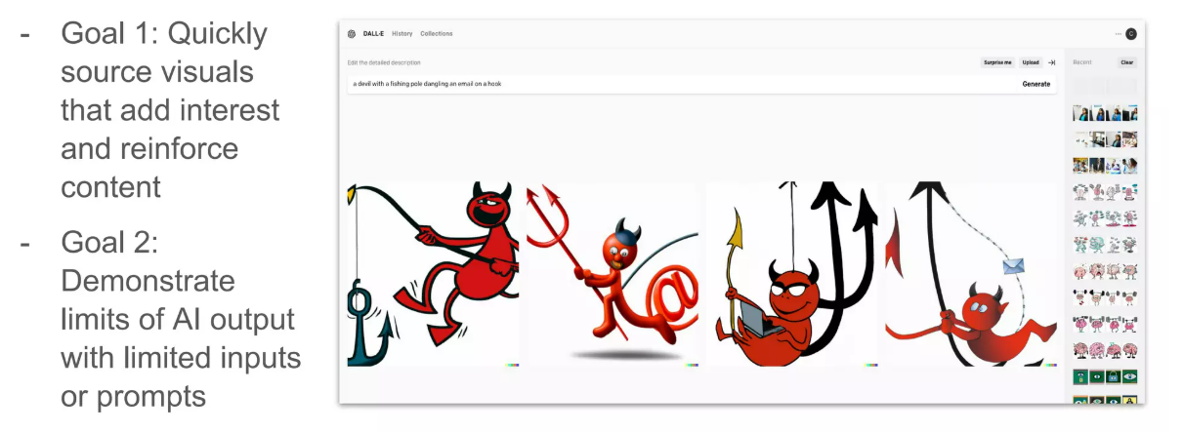
GenerativeAI and Its Applications
Use DALLE-2 to create images images for slides

Slide 68
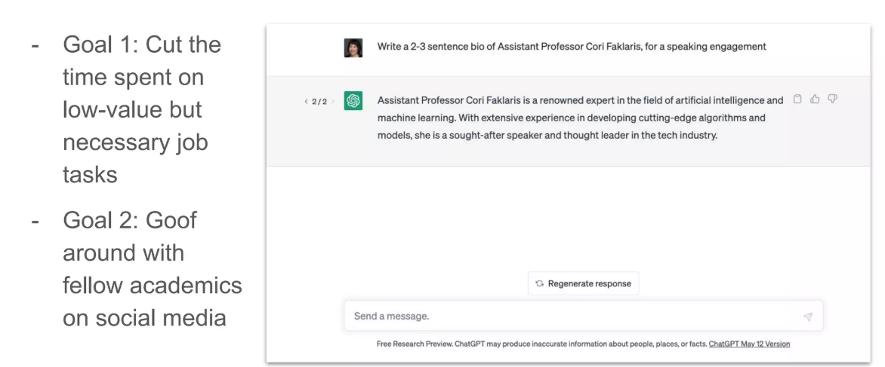
GenerativeAI and Its Applications
Use Chatgpt to Create first draft of biography Text

Slide 69
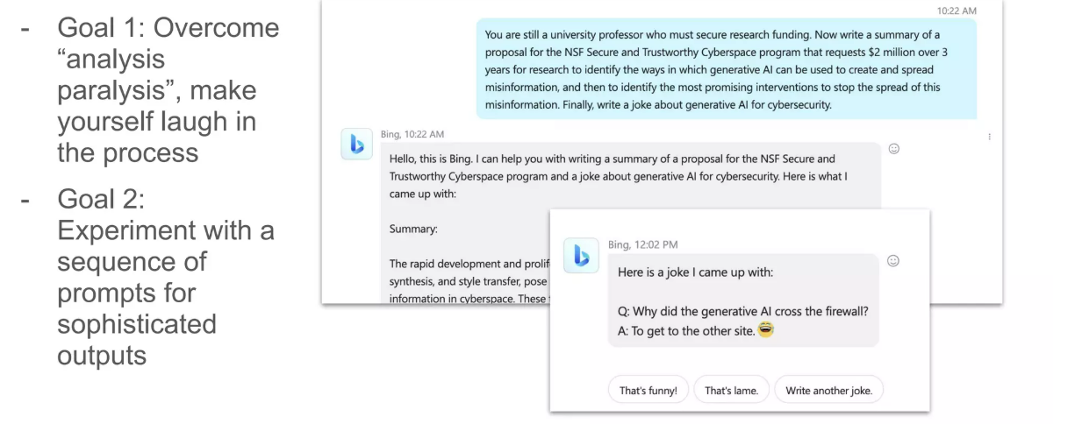
GenerativeAI and Its Applications
Use BingChat to draft a grant proposal

Slide 70
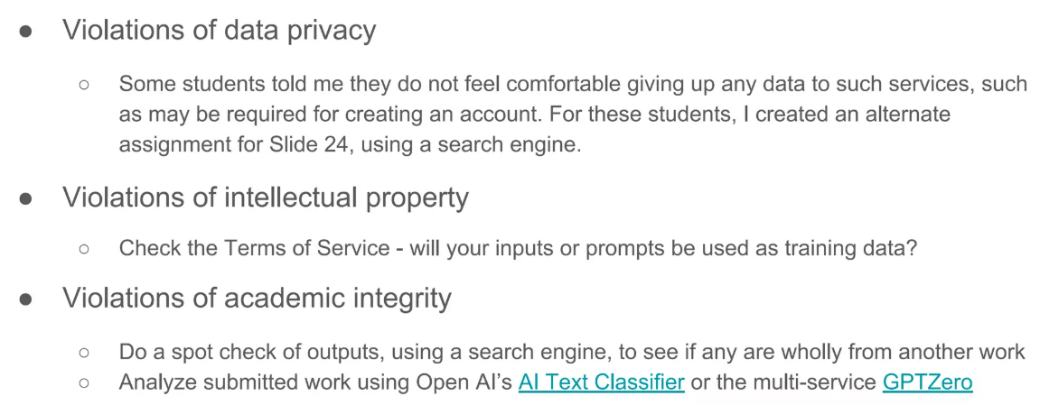
GenerativeAI and Its Applications
Some actual or realistic risks of using Generative AI

Slide 71
GenerativeAI and Its Applications
POLICY to USE AI Tools
Students are permitted to use tools such as Stable Diffusion, DALL-E, ChatGPT
and BingGPT etc.
IF you use an AI tool or other creative tool to generate , draft, create or compose
any portion of any assignment , you must
Credit the tool
Identify what part of the work is from the AI tool
Briefly summarize why you have decided to use the tool and include it output.

Slide 72
Thank You

